Slide 1
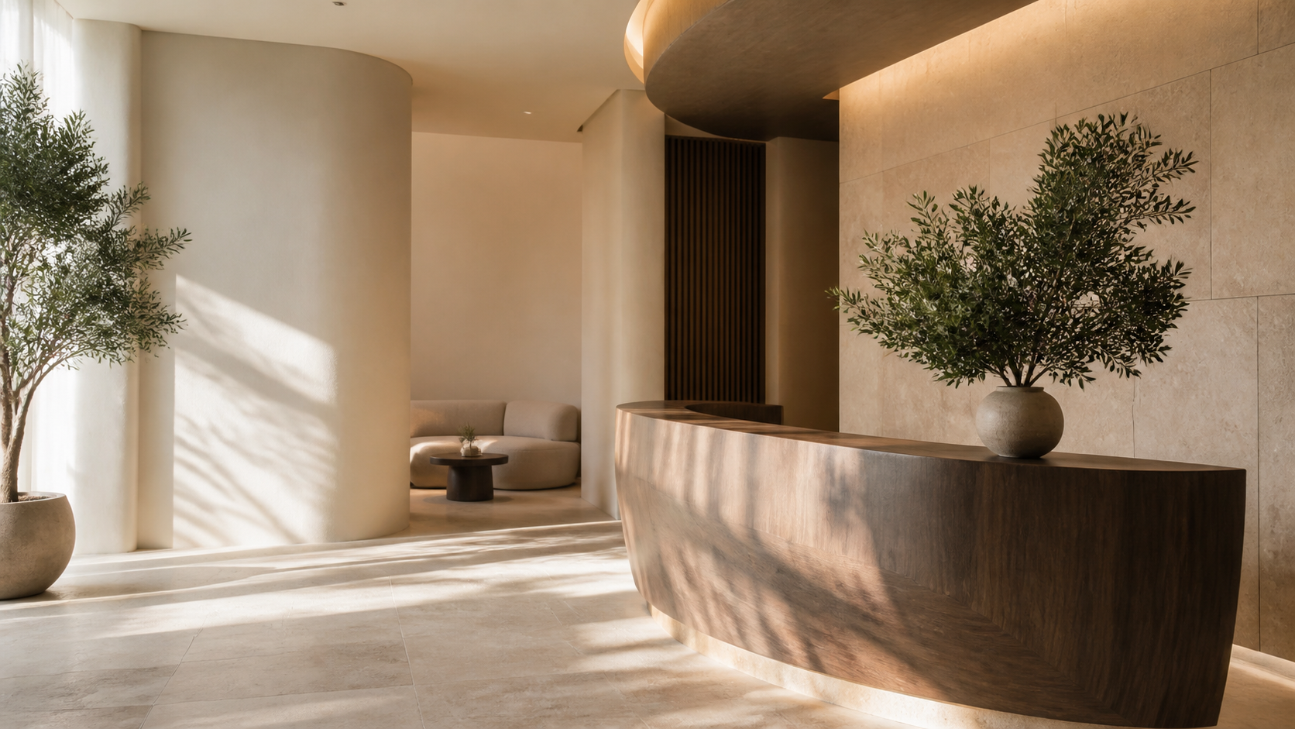
VELORA
Notes:
[Sources]
- OpenAI image generation; original fictional campaign asset: reception.png
[/Sources]

Slide 2
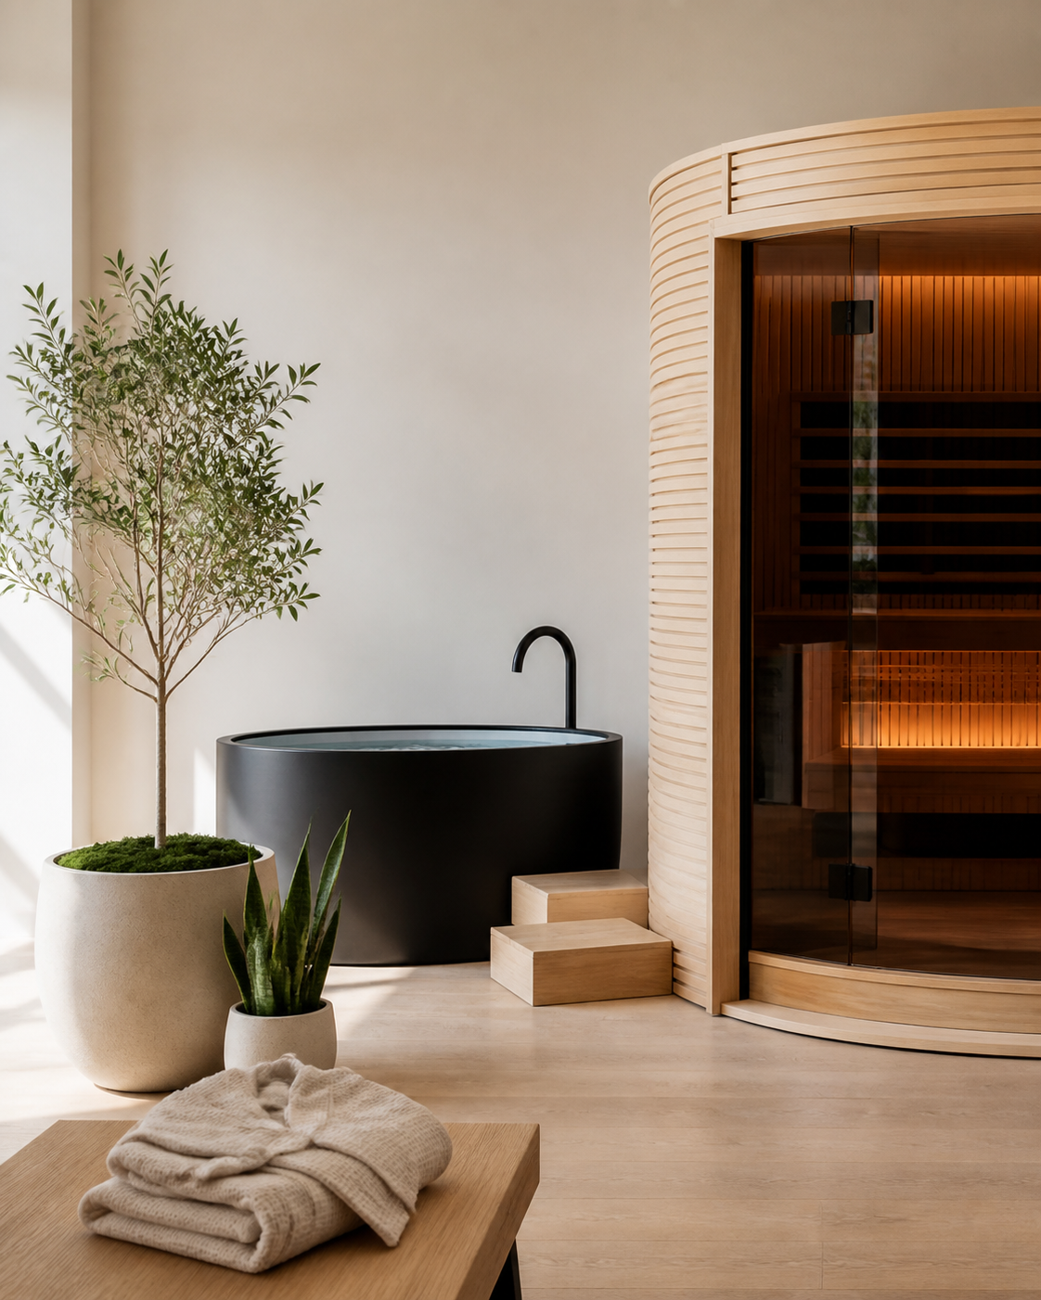
POSITIONING
A full-service urban sanctuary that combines high-touch spa rituals with modern recovery and skin expertise.
PROMISE
VELORA
You leave feeling more like yourself.
AUDIENCE
Design-conscious guests who want visible results, genuine rest and rituals worth returning to.
02
Notes:
[Sources]
- No external sources. Original fictional brand strategy and copy.
[/Sources]

Slide 3
V
VELORA
R I T U A L S P A
R I T U A L S P A
VELORA
PRIMARY WORDMARK
MONOGRAM
Use for exterior signage, menus and campaign mastheads.
Use for social avatars, seals, gift cards and small-format touchpoints.
02
Notes:
[Sources]
- No external sources. Original fictional brand strategy and copy.
[/Sources]

Slide 4
Color and Typography
BONE
SAND
SAGE
ESPRESSO
RITUAL AMBER
#F3EEE6
#CDBFAE
#8C9685
#312B28
#B18359
HEADER | NEWSREADER 36PT
BODY | MONTSERRAT LIGHT
Editorial warmth for names, headlines and elevated moments.
Clear structure for menus, details, prices, captions and calls to action.
04
Notes:
[Sources]
- No external sources. Original fictional brand strategy and copy.
[/Sources]

Slide 5
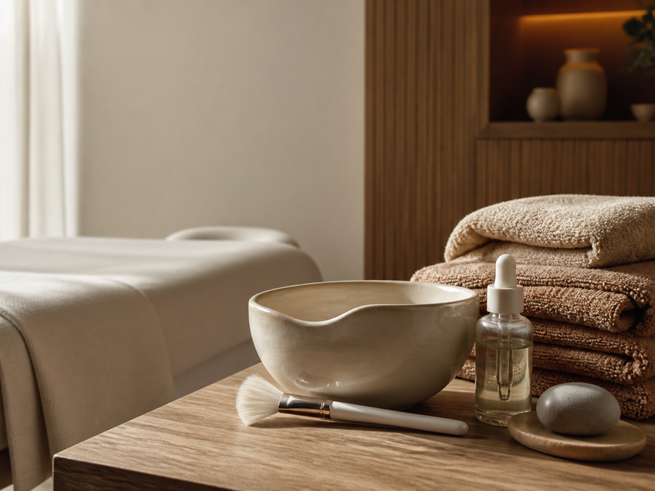
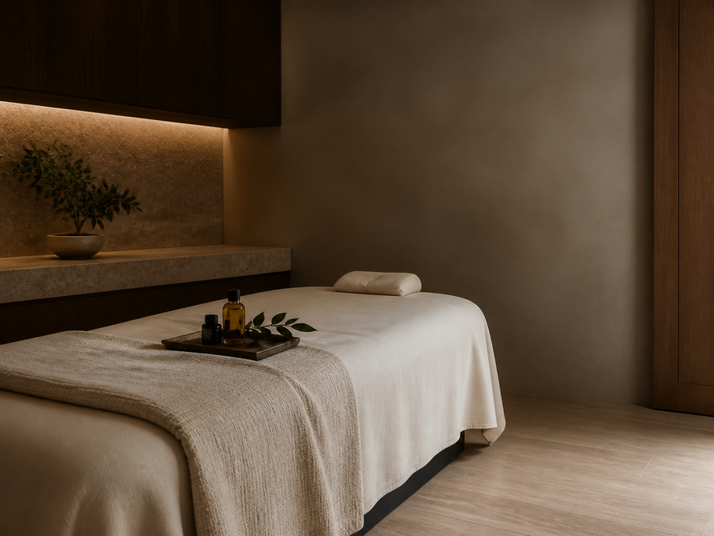
Photography Direction
DETAIL
SPACE
RITUAL
Natural texture · warm shadows · honest materials · calm composition
05
Notes:
[Sources]
- OpenAI image generation; original fictional campaign asset: facial.png, massage.png, recovery.png
[/Sources]

Slide 6
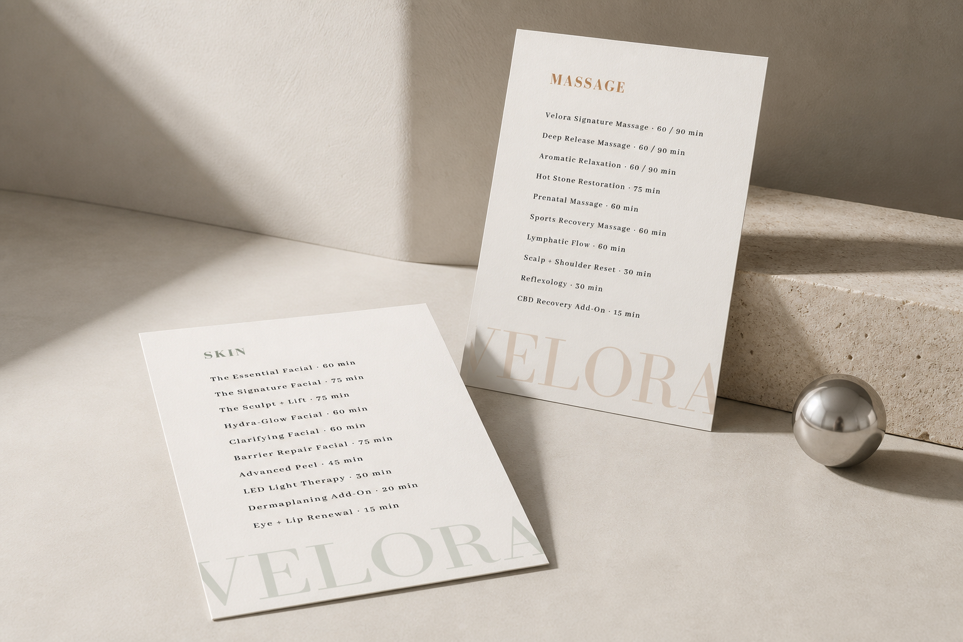
Spa Menu
08
Notes:
[Sources]
- OpenAI image generation; original fictional campaign asset: recovery.png
[/Sources]

Slide 7
VOICE & MESSAGING
Sound calm.
Say something.
WE ARE
Assured · warm · sensory · concise
WE AVOID
Wellness jargon · exaggerated claims · urgency · perfection language
10
Notes:
[Sources]
- No external sources. Original fictional brand strategy and copy.
[/Sources]

